Slide 1
Contribution History Log
Slide | Contributor | Date
2, 3 | Matt | 9/14/2017
4, 5 | Brandon | 9/14/2017
6, 7 | Joseph | 9/14/2017
8 | Erik | 9/14/2017
9 | Kyle | 9/14/2017
10 | Evan | 9/14/2017
*Slide numbers start from the title screen

Slide 2
Brand Central Station
Brandon Jackson, Erik Culberson, Evan Bradley, Kyle Schrade, Joseph Herkness, Matthew DeMott

Slide 3
Problem Statement
Looking for a type of product
Two choices, drive around to stores or shop online
Scanning the internet is time consuming
Driving to stores takes time and wastes gas

Slide 4
Retail trends
Retail sales in stores are decreasing
Many companies are cutting physical store locations
Sales shifting to e-commerce
42% of retail growth went to online sales

Slide 5
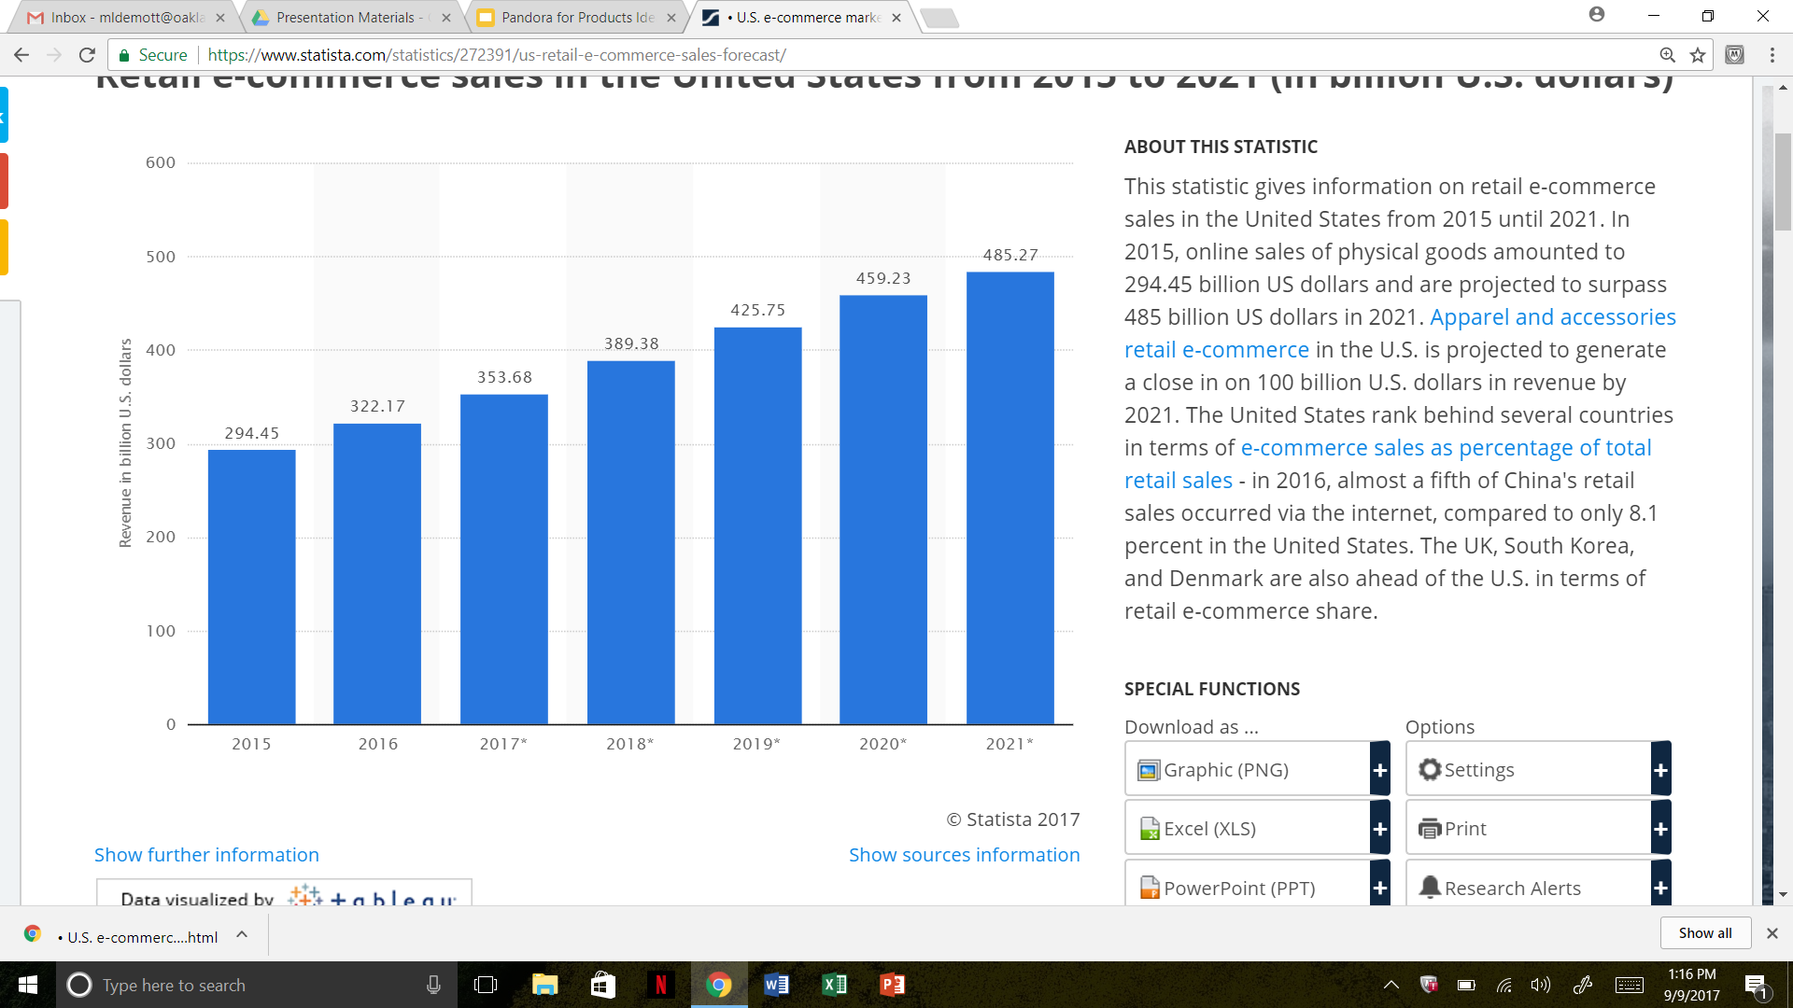
Online Retail Sales
The Statistics Portal

Slide 6
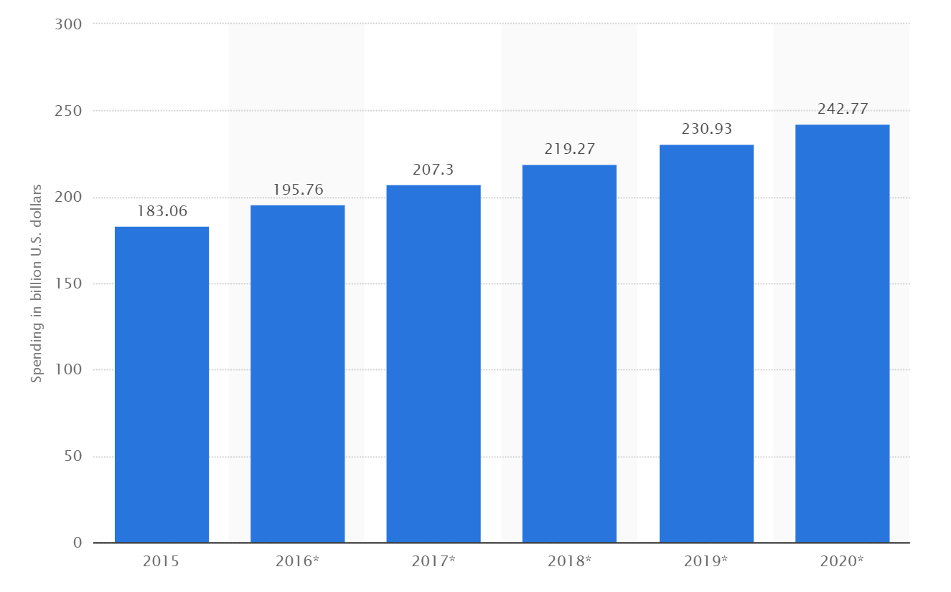
Advertising
The Statistics Portal

Slide 7
Project Proposal
An application that does the product searching for you
Think Pandora for merchandise discovery
Learn and adapt based on what the shopper likes or dislikes.
If the shopper likes it, we will show them similar products
If the shopper hates it, they won’t see it again.
Channels provide a way to find specific types of products.
Hats, Electronics, Nike, Documentation Tools
The products the shopper likes will be saved so they can find them later.
An easy and fun way for a shopper to discover new products.

Slide 8
Proposal Continued
Alternative to advertising for businesses.
Finds the shoppers who are most likely to purchase your product and recommends it to them.
Ease of online shopping without the hassle.
Gathers a diverse range of products into a centralized location.

Slide 9
Project Information
Configuration Management
GitHub
Web Application Framework
Symfony
Database
MySQL
Server Setup
Ubuntu Server
Languages
Vue, PHP, Node, Python/Javascript

Slide 10
General Team Roles
Erik
Back End, Server Admin
Evan
Back End, Server Admin, Data Collection
Brandon
Database, Back End, Data Collection
Joseph
Front End, API Setup
Kyle
Front End, API Setup
Matthew
Documentation, Front End, Database

Slide 11
Next Sprint Objectives
User registration
Login
Logout
Profile Page
Edit Profile
Email Verification
Design and setup database
Basic framework for website

